Slide 1
Oliver Bowker DC4400 Viva
Extension of the BBC iPlayer off product schedules system to process change notifications

Slide 2
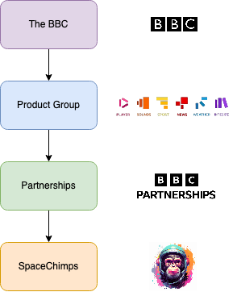
Place in the organisation
I am part of team SpaceChimp which is part of the partnerships group, which itself is part of the overall product group.

Slide 3
What we do as a team?
We provide APIs, of which we also generate the data, for off-product (non-iPlayer) related partners.
Catalogue pipeline (Contains episode, series and brands)
Different timescales/horizons, 0-day, 8-day and unfiltered.
Schedule pipeline (Contains schedules)
1 schedule, per day, per service.
Each schedule contains a list of broadcasts.
Each broadcast has titling, programme description and viewer discretion warnings forwhich it relies on the catalogue pipelines data.

Slide 4
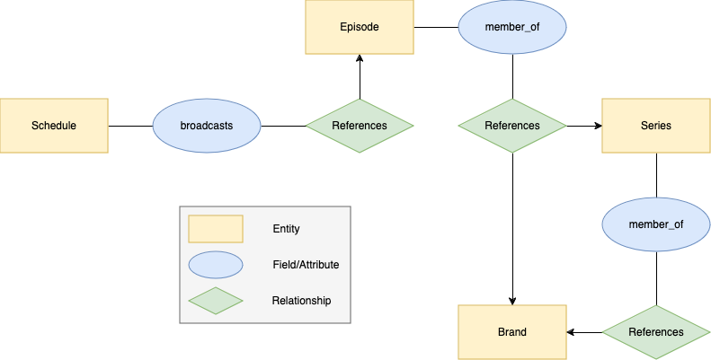
How the data links together?

Slide 5
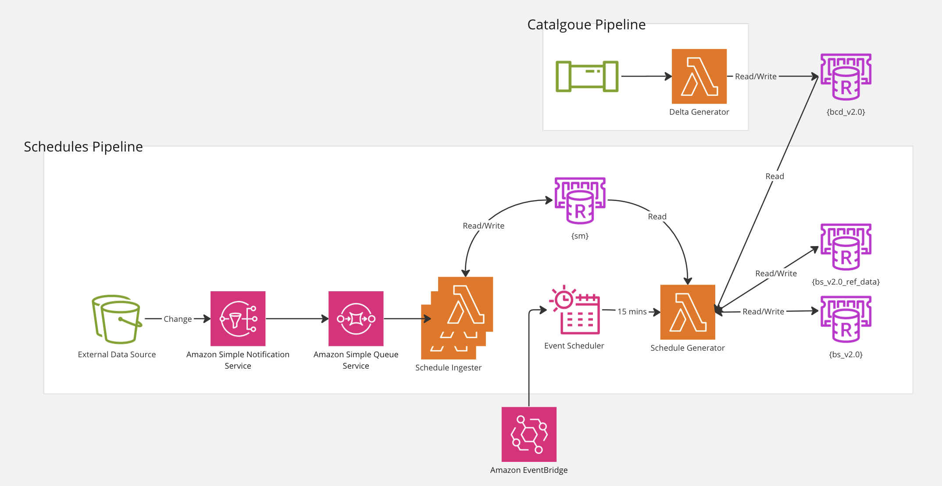
Starting architecture

Slide 6
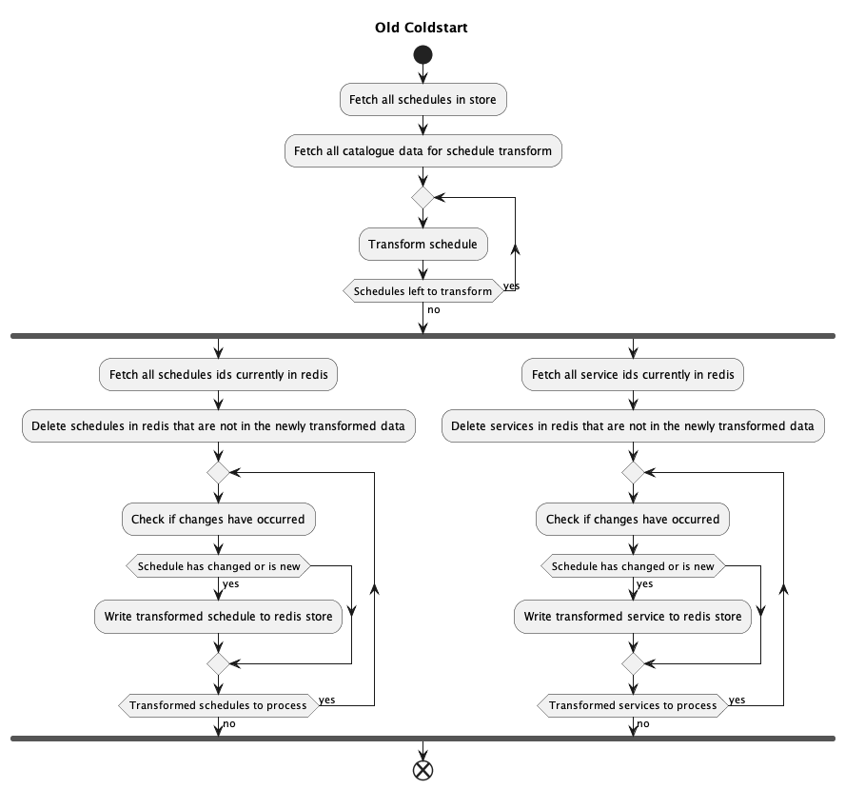
Starting functionality
Data is fetched from an internal model and transformed into its external format every 15 minutes.
This transformed data includes the schedule itself as well as the service (e.g., BBC1) that the schedule is for.

Slide 7
Project Goals
Update the schedule generator away from a static generation approach to an event/notification-based system.
Have schedule data for partners be as up to date as possible.
Allow notifications direct to partners in future work.

Slide 8
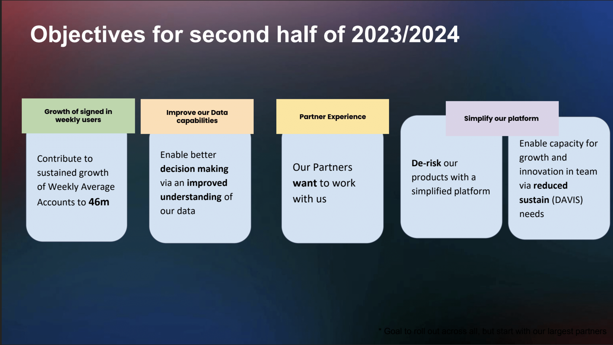
How it meets our OKRs
It helps drive growth as we can get content out to more people on more devices, increasing exposure to the BBC.
It helps us improve our partner experience by working with them on integrating better data into their feeds.
We simplify our platform as this helps us no longer rely on an external data provider for providing schedules.
This project should reduce the total time processing data, which therefore reduces our costs and makes us more sustainable.

Slide 9
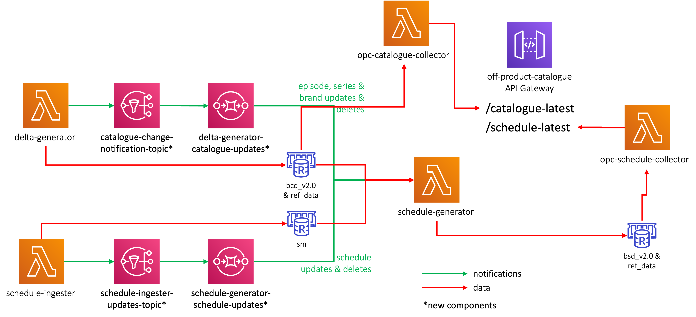
Initial Design

Slide 10
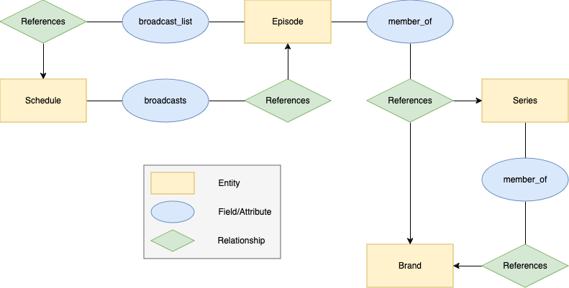
Handling titling changes
A list of schedules is to be kept per episode that is referenced in a schedule's broadcasts.
When an episode update is processed by the schedule generator, schedules that reference it can also be easily updated.
This keeps the data correct and doesn’t rely on schedule updates alone to update titling and other catalogue related fields.

Slide 11
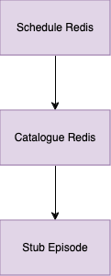
Initial Architectural Decision
An architectural decision was made to have all data referenced in a schedule be in the same Redis key space/store.
This results in copying over episode, series and brand data related to schedules from the catalogue store over to the schedule store.
This ensures the API Gateway can retrieve all its information from one source and keep its integrity and self-consistency.
This also allows us in the future to edit this data per pipeline, changes can be made to the schedules episode schema without breaking current catalogue integrations.
This copying of data and the broadcast list associated with episodes results in the system being single threaded, due to shared memory concerns.

Slide 12
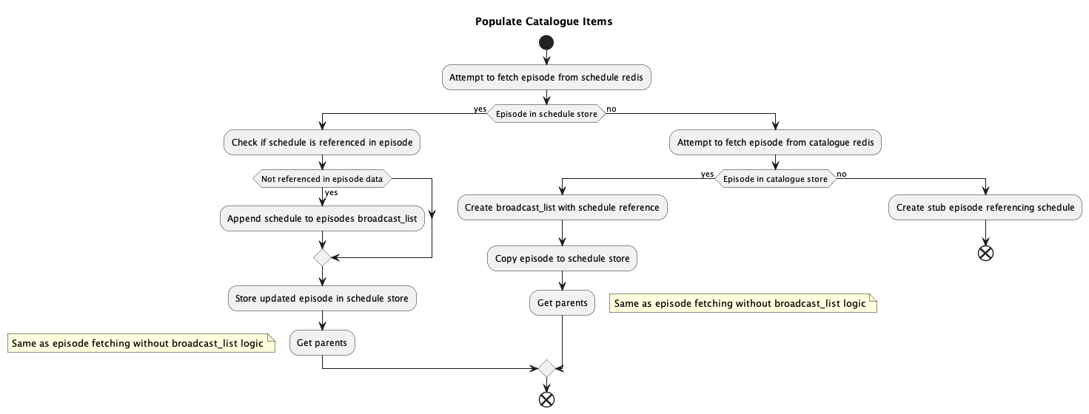
Initial Architectural Decision
On schedule update the following logic occurs for each broadcast in the schedule:

Slide 13
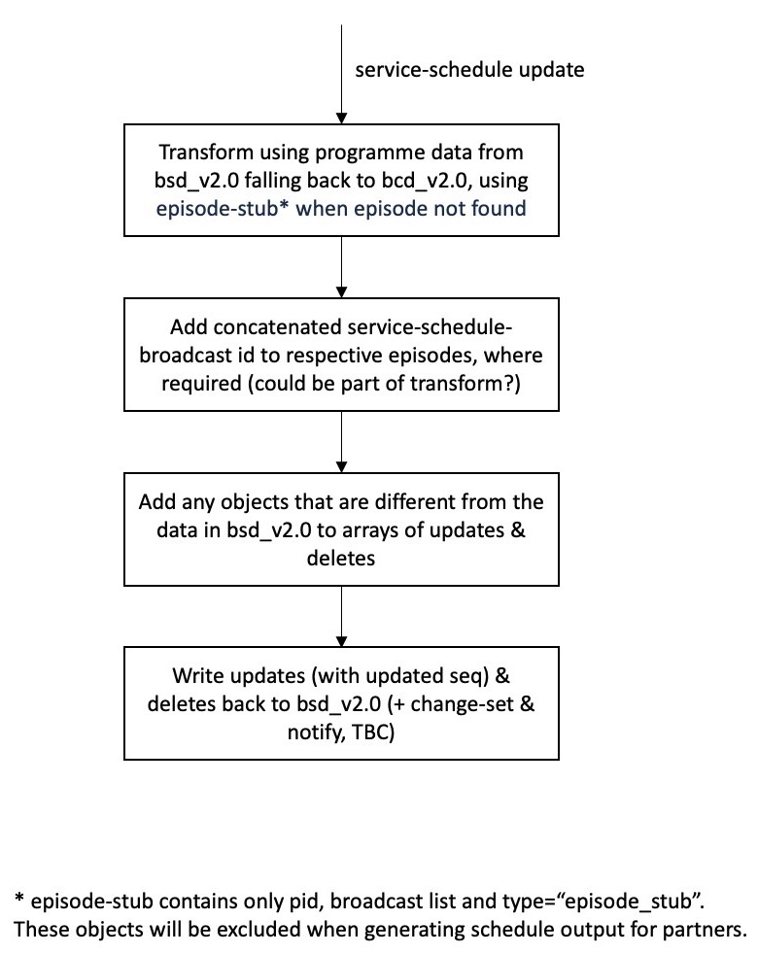
Initial Algorithm: Schedule Update Notifications

Slide 14
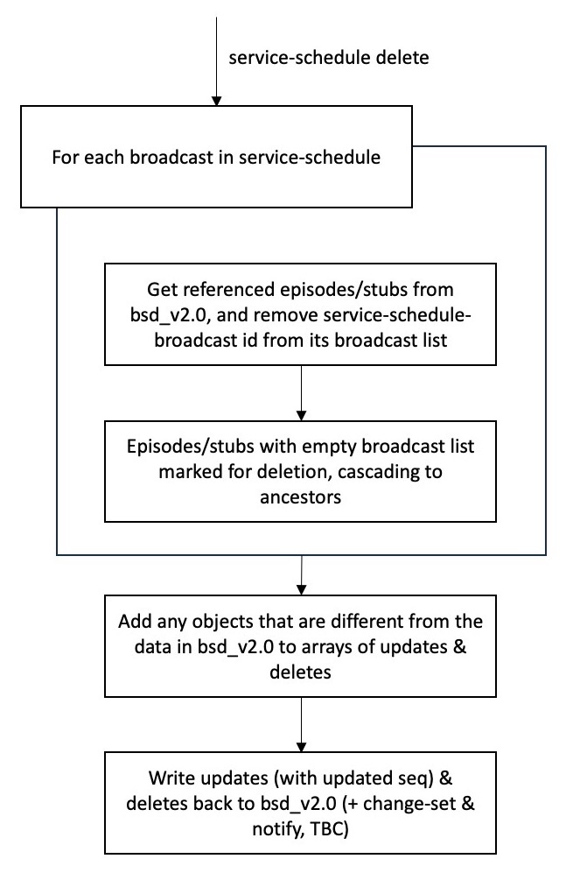
Initial Algorithm: Schedule Delete Notifications

Slide 15
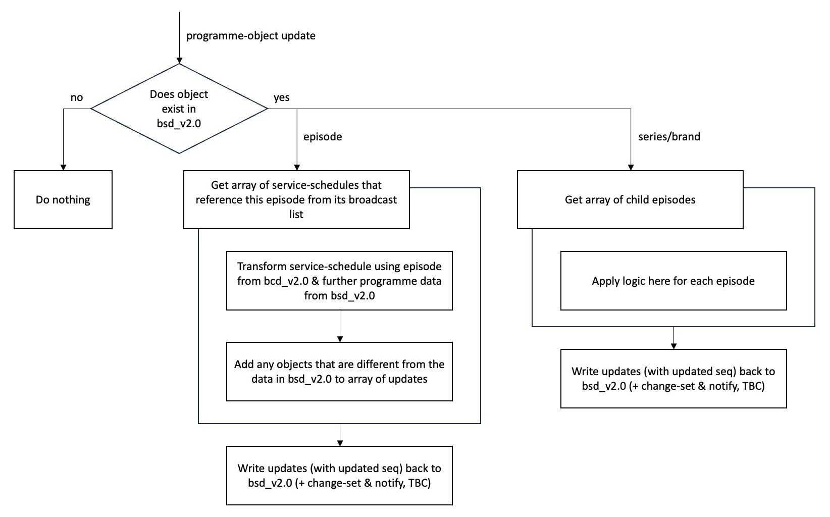
Initial Algorithm: Catalogue Notifications

Slide 16
Software Spike (Changes)
A spike was done to improve and test the proposed architecture and algorithm outlined in the initial design. This was done by myself, and a fellow junior software engineer and the following changes were made to the initial design:
Catalogue delete notifications did not need to be handled as they could be handled by schedule notifications.
A ‘garbage collector’ could be used to lower the complexity and number of Redis gets when removing an episode. Only schedules and episodes are to be removed by the schedule generator, with series and brands being removed by the garbage collector.
Schedules updated due to an episode notification should be done concurrently to save time.
Only need one queue for the schedule generator, not 2 as was depicted in the initial architecture design.

Slide 17
Software Spike (Issues)
Copying the data between Redis’ added significant complexity to the code.
Due to the broadcast list linking episodes and schedules being stored in Redis, parallelisation in the future will be a challenge.
Unrelated to the code, the spike had no timebox assigned to it, which led to scope creep.

Slide 18
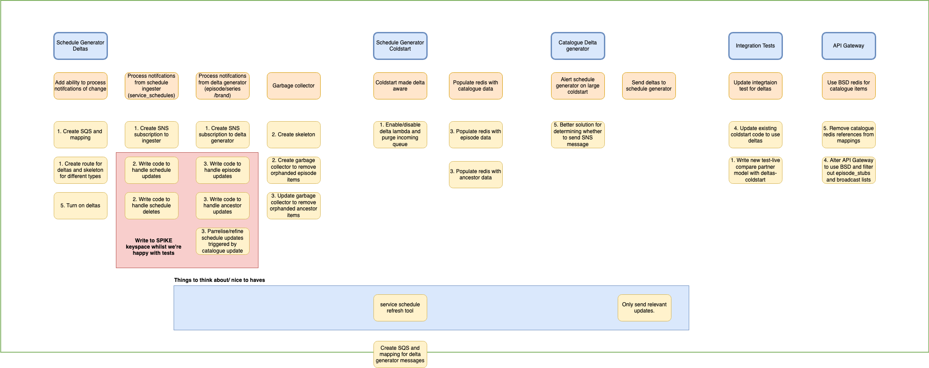
Ticket Slicing

Slide 19
Ticket Slicing /Feature Sets (Challenges)
The ordering into feature sets, slicing and creation of tickets was done in a day.
Further discussion and investigation should have been done to fill in gaps and larger tickets should have been split into smaller pieces of testable work.
This part of the process felt rushed and larger issue came up down the line due to this.
This being my first time slicing a project, made the above issues a good learning experience for future projects
The diagram created showing the tasks should have been made clearer, it was separated into components, being separated into deliverables would have been better.

Slide 20
Final Feature Sets
The above diagram was put into Jira tickets and after some conversations and moving around four feature sets were outlined to meet the MVP.
Create infrastructure needed to handle notifications
Handle notifications for schedules (updates/deletes)
Handle notifications for catalogue (updates)
Integration/comparison tests, documentation and switchover to new system

Slide 21
Development Work
Notification Lambda
Garbage Collector
Coldstart (Data Refresh) Lambda
Integration and Comparison Tests

Slide 22
Notification Lambda
The notification lambda is to handle 3 types of events
Schedule updates
Schedule deletes
Catalogue updates (episode and ancestor)

Slide 23
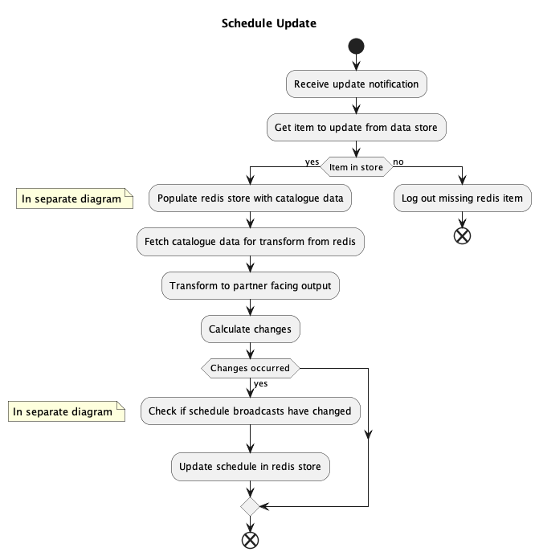
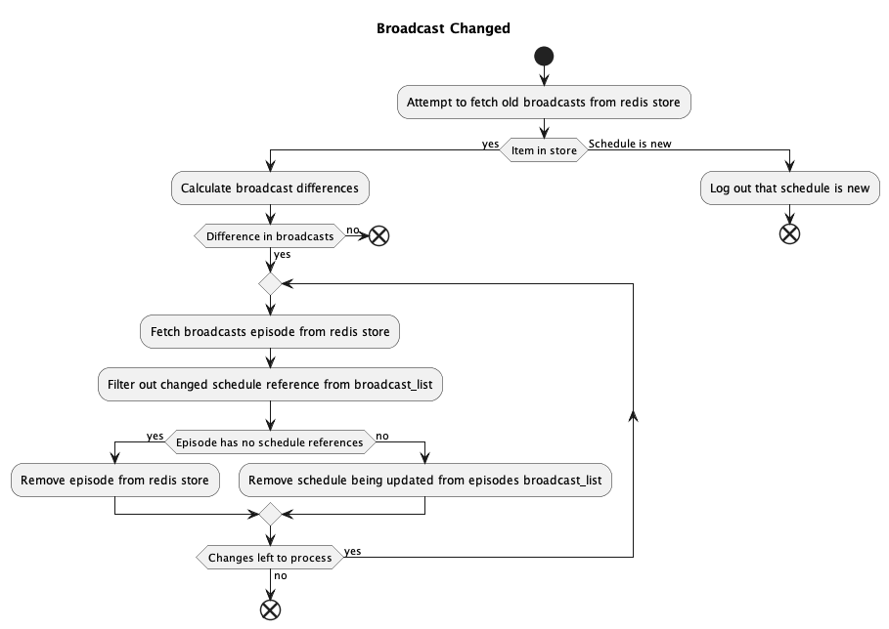
Notification Lambda (Schedule Updates)

Slide 24
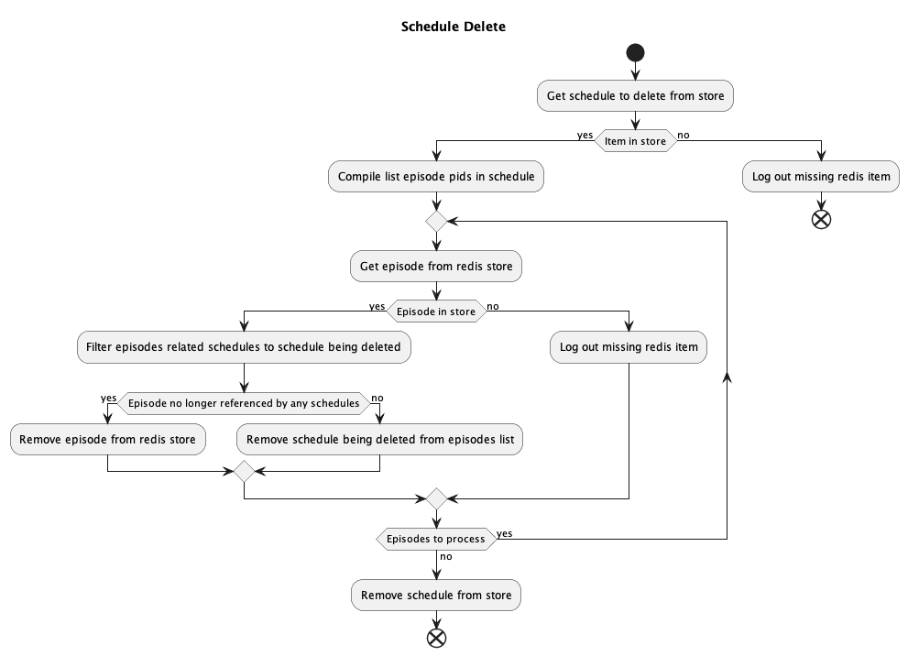
Notification Lambda (Schedule Deletes)

Slide 25
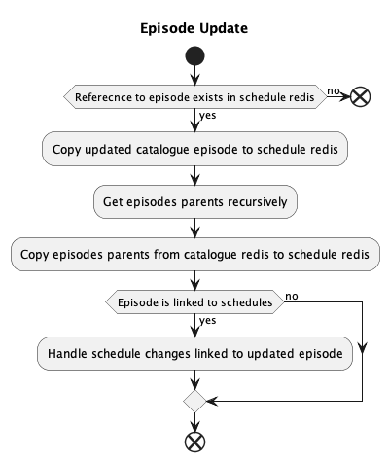
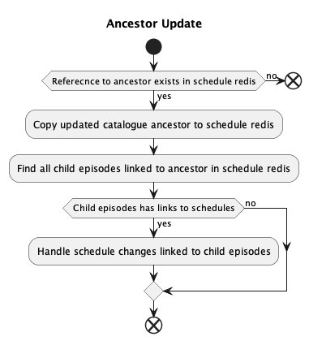
Notification Lambda (Catalogue Updates)

Slide 26
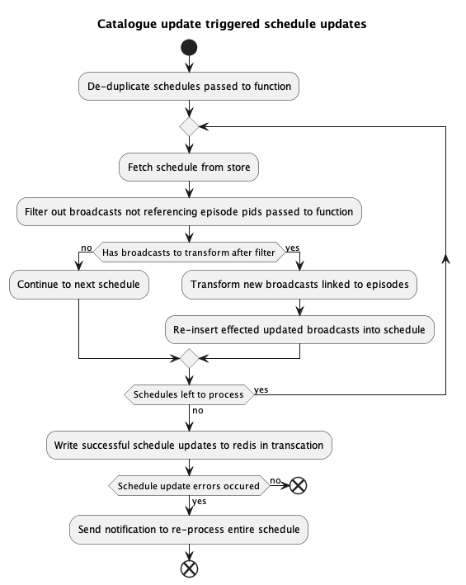
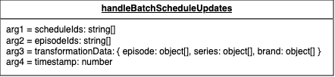
Notification Lambda (Schedule updates triggered by catalogue update)
As previously mentioned, catalogue updates can change the titling and descriptions within schedule documents.
The spike found that these schedule updates should be done concurrently, otherwise the lambda runtime and number of items in the queue for the lambda could grow large.

Slide 27
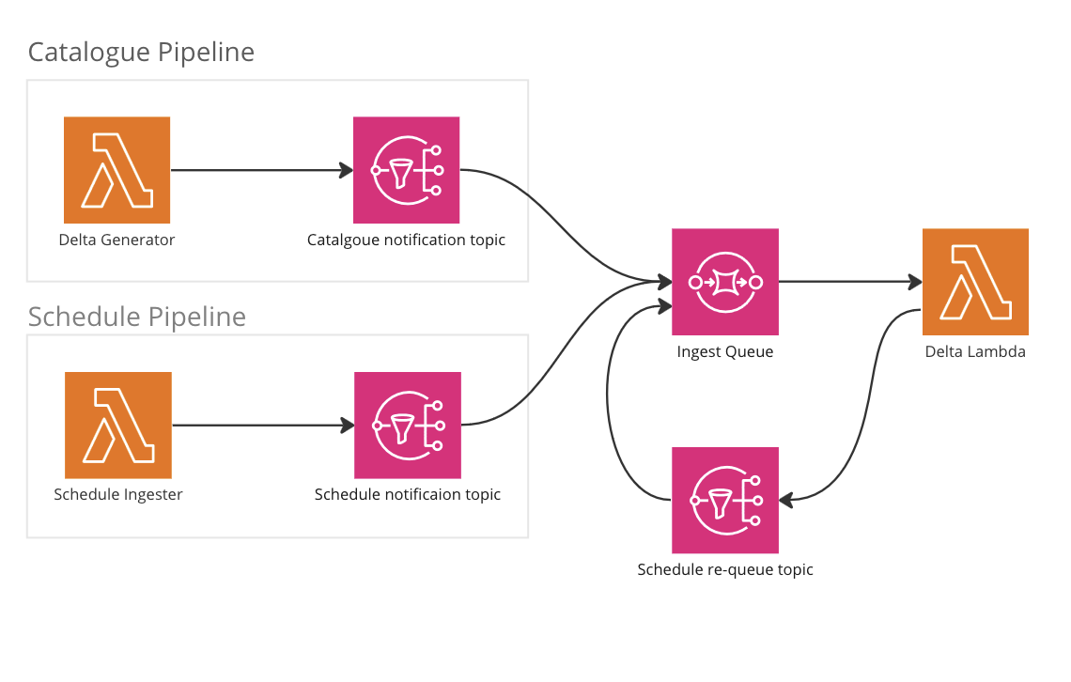
Notification Lambda (Schedule updates triggered by catalogue update)
With schedule updates now being done concurrently, errors handling must be changed.
If 1 schedule out of 10 fail, we don’t want to re-process everything again.
For this an extra SNS that feeds into the schedule generator SQS was added to requeue any schedules events that fail.

Slide 28
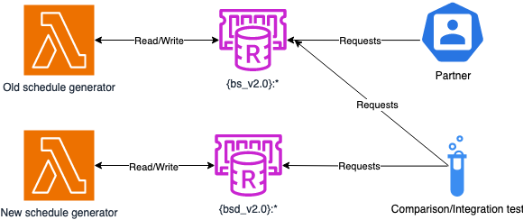
Notification Lambda (Challenges)
The code had multiple points of complexity, the key ones being:
Copying data from the catalogue Redis to the schedule Redis.
Schedule updates triggered via a catalogue update.
The latter of these is now solved but took a long time to develop, with the prior remaining a potential issue. There are potential solutions to this problem that the team has identified.
It became apparent as development began that we would need to run new and old system side-by-side to be safe, with the new system writing its data to a separate key space as to not effect partners on Live, but still allow us to deploy to Live using our CI/CD tools.
The original thought was that if the notification lambda wrote to its own key space everything would be fine. However, it quickly became apparent that without a duplicated ‘notification coldstart’, resetting the data would be very challenging.

Slide 29
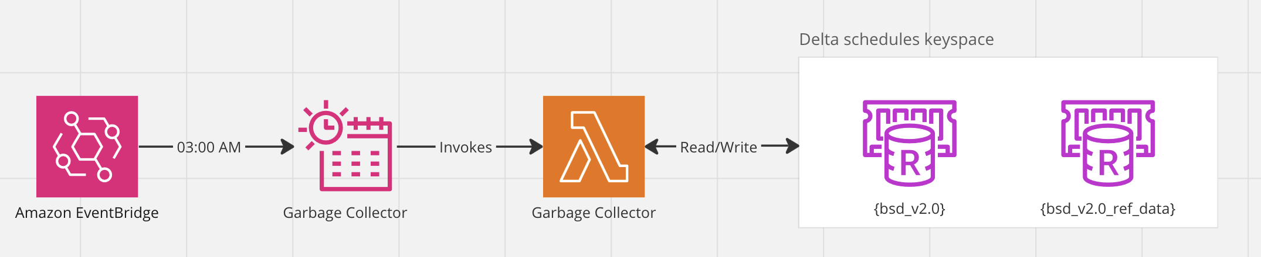
Garbage Collector Lambda
A lambda was created and scheduled to run at 3am everyday to clear up any orphaned series and brands in the schedules store.
A series or brand was determined orphaned if it had no episodes within its tree.
Doing this once a day removes a lot of processing, code complexity and Redis gets from the schedule generator and system.

Slide 30
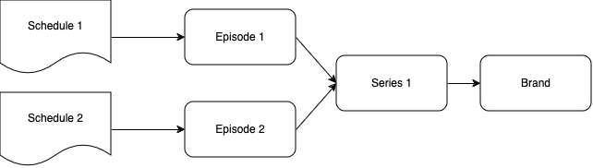
Without a garbage collector
If schedule 1 is removed, episode 1 will also be removed as it’s no longer referenced by any other schedules.
Because the episode is removed, we now need to check the whole tree, to see if the episodes parents (Series 1 and Brand) can also be removed.
Due to the bottom-up nature of referencing (episode → series → brand) all data must be retrieved from Redis to see if anything is still linked to any of the objects.

Slide 31
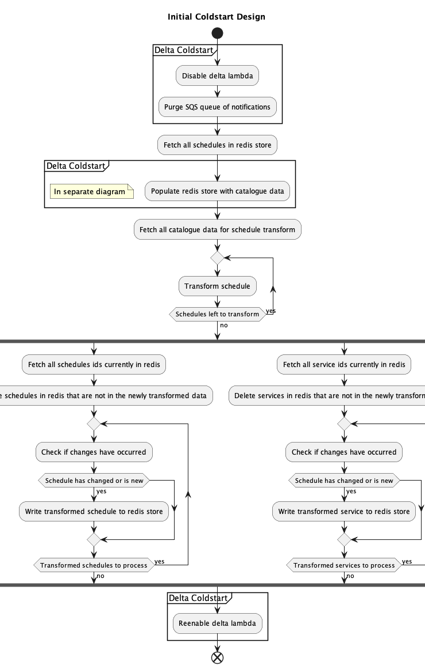
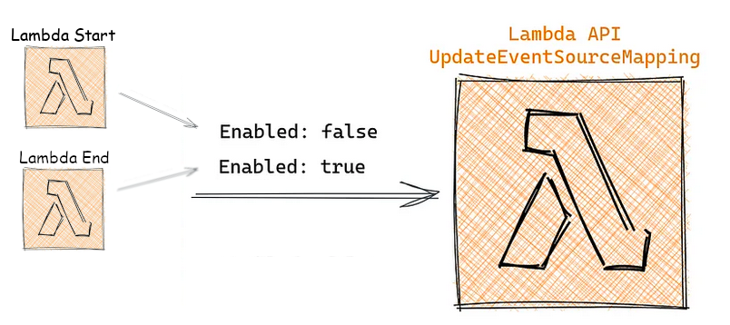
Coldstart Lambda
We are moving our main functionality to an event-based system. However, being able to refresh all data when needed is an important feature to have, data can get to an unfixable state.
The initial design was to build off the current static generation. Temporarily pausing notification processing whilst items in the schedule store were refreshed.

Slide 32
Coldstart Lambda (Challenges)
This design became complex due to the different types of data being stored in the schedule Redis (both catalogue and schedule data).
This was primarily due to the refresh of episodes and managing the list of associated schedules that episode was linked to.
This challenge came up later in development, so a total system re-design was out of the question.

Slide 33
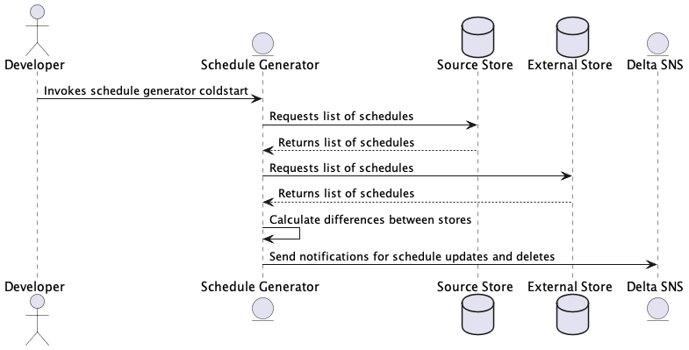
Coldstart Lambda (Solution)
A new solution was devised to re-use the notification lambdas functionality.
On coldstart notifications for all schedules would be re-queued for the notification lambda to process.
If the schedule is not in the source store but is in the external store, a delete notification is sent.
An update notification is sent for every schedule in the source store.

Slide 34
Integration Tests, Comparison Tests and Release Strategy
With two systems running in parallel a switchover strategy needed to be devised.
New integration and comparison tests ran against the new system and its outputs are used to help us gain confidence that the new system is working as expected.
It was decided that if these tests pass continuously for one week, partner could be switched over to the new data set.
Comparison tests of the new and old system would continue to run after switchover to help catch any bugs that may still exist.
After enough time, the old static system and the comparison tests between the new and old system will be retired completely.

Slide 35
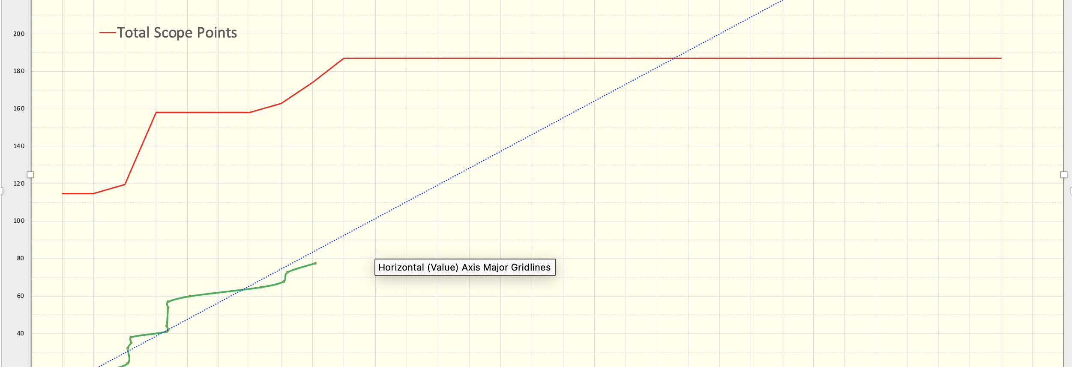
Outputs (Burn Up Charts)

Slide 36
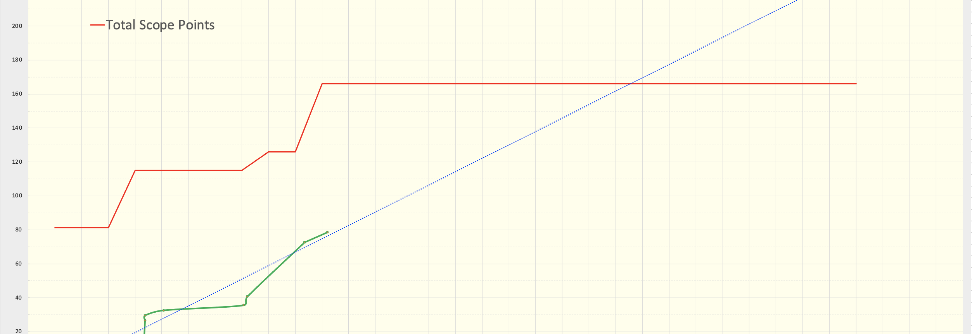
Outputs (Burn Up Charts)

Slide 37

Outputs (Burn Up Charts)

Slide 38
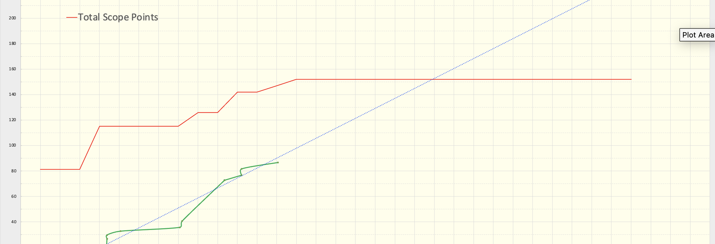
Outputs (Burn Up Charts)

Slide 39
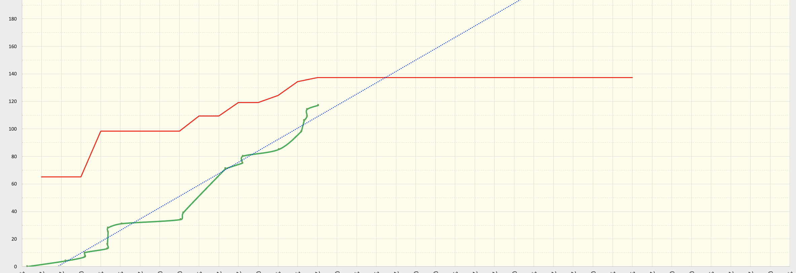
Outputs (Burn Up Charts)

Slide 40
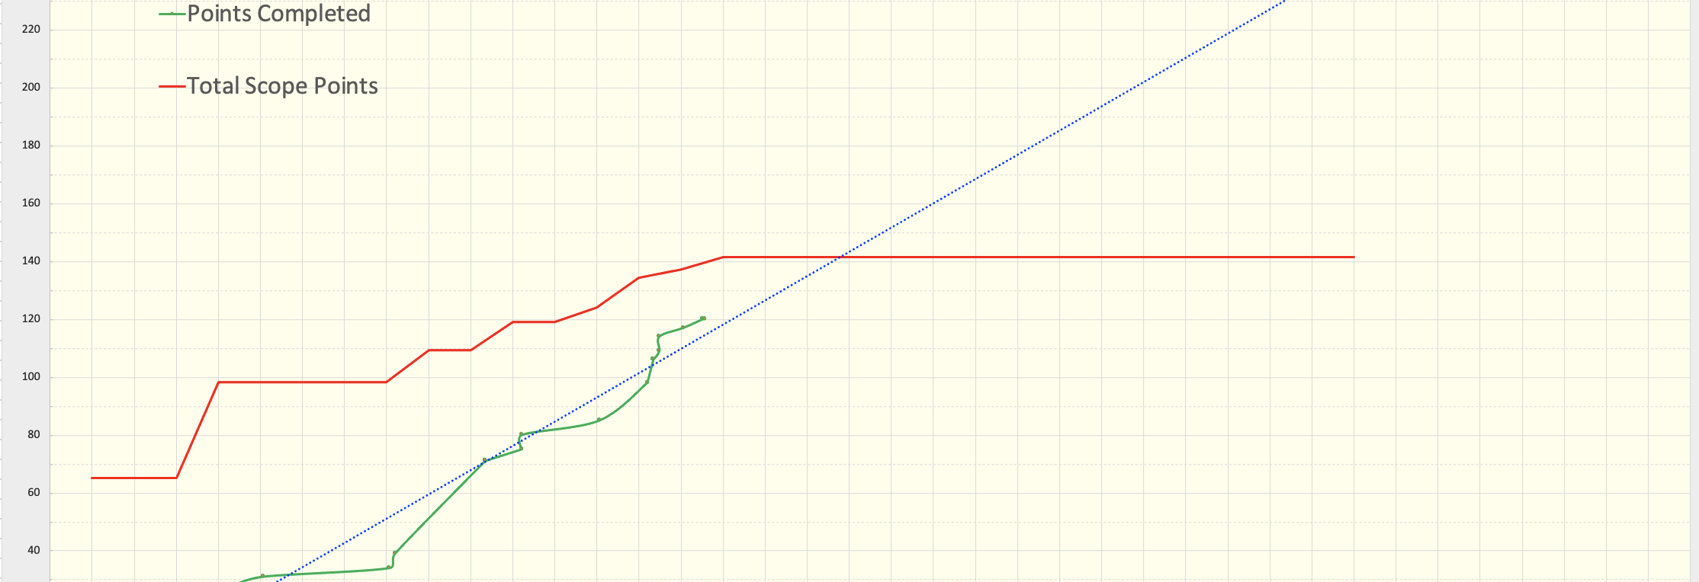
Outputs (Burn Up Charts)

Slide 41
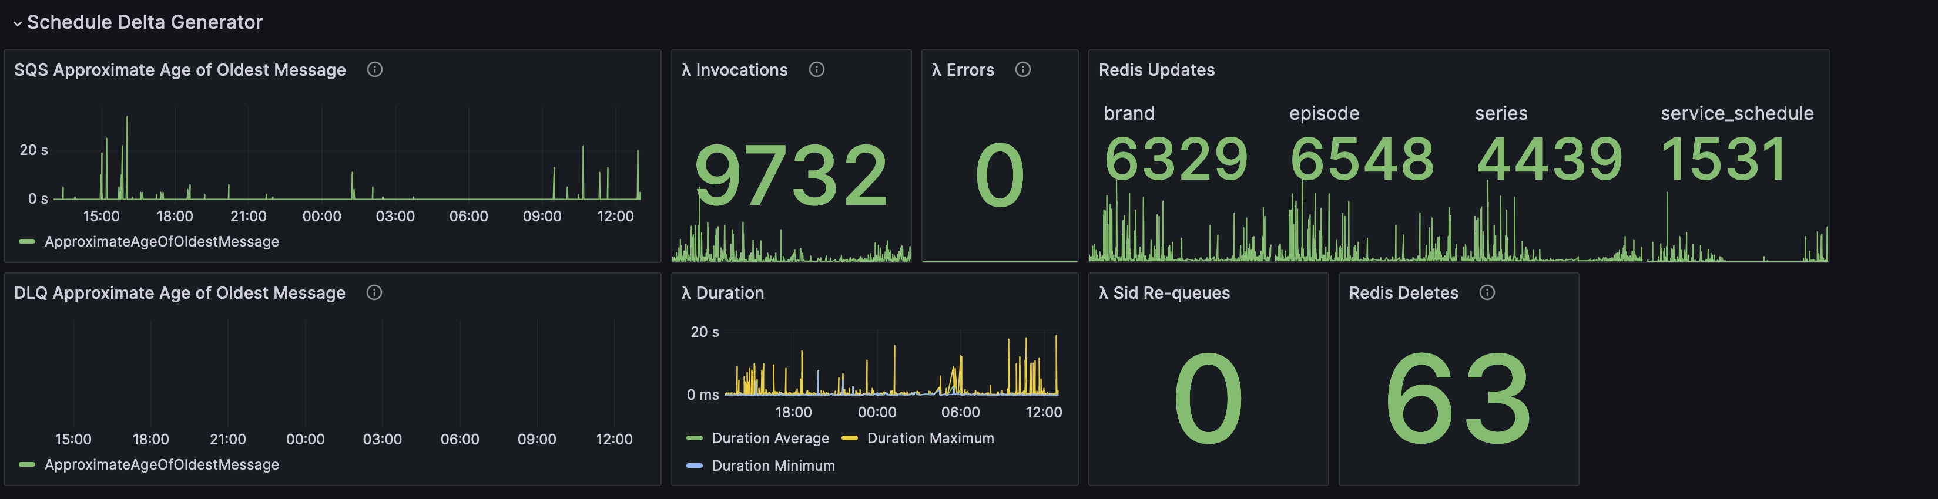
Outputs (Dashboard)
monitoring.collect({
typeId: 'Processing’,
result: 'throughput’,
dimensions: {
ObjType: 'service_schedule’,
EventType: 'Delete’
},
value: 1
})

Slide 42
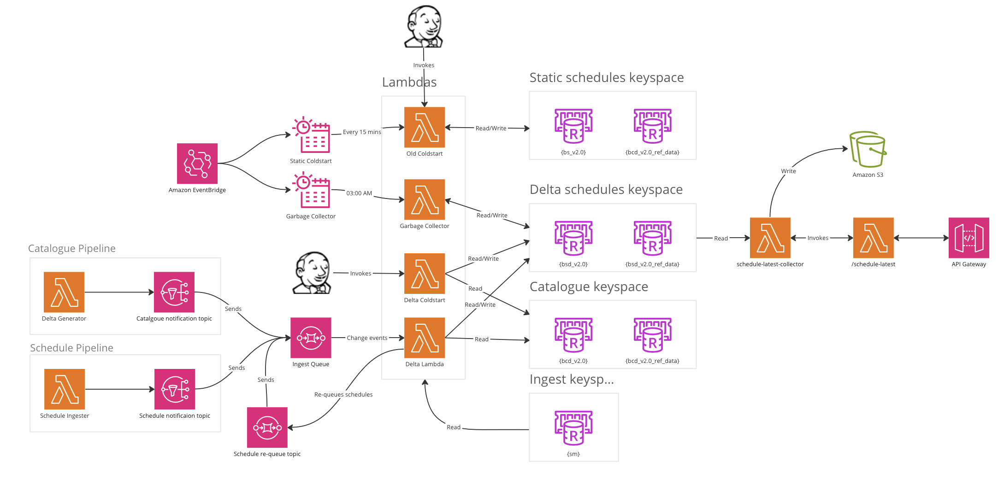
Outputs (Final Architecture)

Slide 43
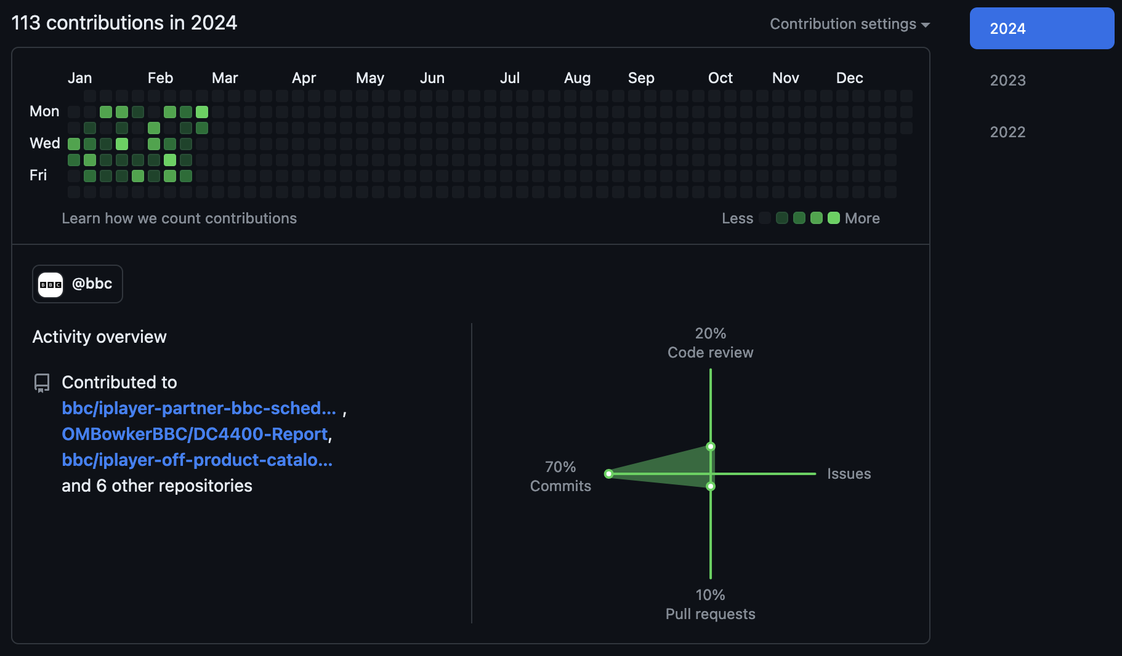
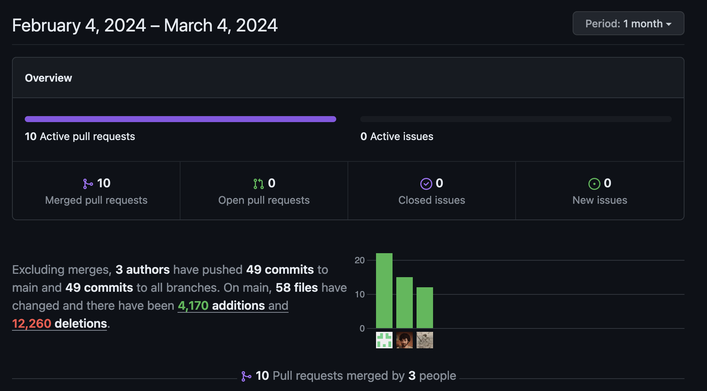
Outputs (Code)

Slide 44
Future Work (Garbage Collector Consolidation)
The current system breaks the principle of separation of concern (SoC).
Schedule generator should be concerned with the deletion of schedules and not the deleting of episodes.
This would also make the schedule generator less complex.
Deleting the episode straight away instead of through the garbage collector has no negative impact on partners, or the output of the system.

Slide 45
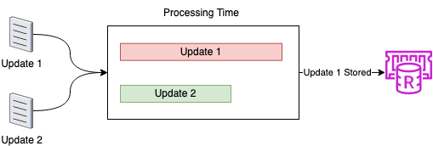
Future Work (Allow Parallelisation of Notifications)
The current system is hard to parallelise due to the shared broadcasts list contained in the episode.
Even with this being pulled out into a separate Redis key, race conditions can still destroy the integrity of the data.
This could easily get out of sync if parallelised updates interfere with one another. This is would primarily be caused by a catalogue and schedule update that are linked to one another being processed at the same time.
So, we need a way to ensure that data is not being written back to the store after another change has beaten it in processing.

Slide 46
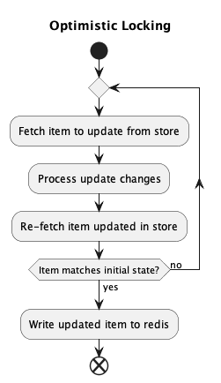
Future Work (Allow Parallelisation of Notifications)
DynamoDB could be used alongside it’s optimistic locking features to maintain data integrity when writing to the store.
DynamoDB could also help stop updates that have nothing to do with schedules triggering a schedule generator run.
This could also lower the complexity, with the broadcast list now stored separately there would be an argument to no longer copy data over from the catalogue Redis to the schedules Redis. This would drastically lower the complexity of the schedule generator code.

Slide 47
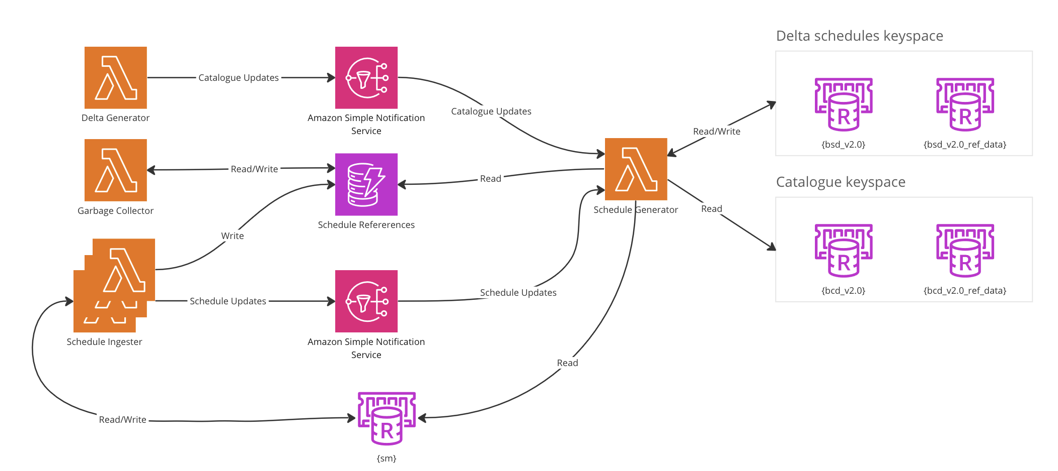
Future Work (Allow Parallelisation of Notifications)
Id (Pid) | Associations | Version
Unique identifier for catalogue item. | For episodes -> schedules For ancestors -> children | Column used to optimistically lock.

Slide 48
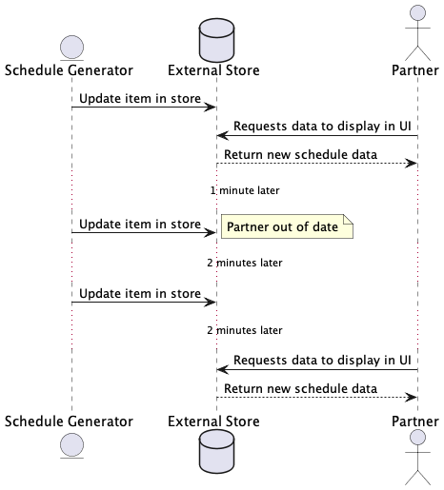
Future Work (Changesets/Notifications to Partners)
The current system updates our partner facing store, however, does not alert partners that data has changed.
This can result in partner UI being of date, until the partner re-requests the data.

Slide 49
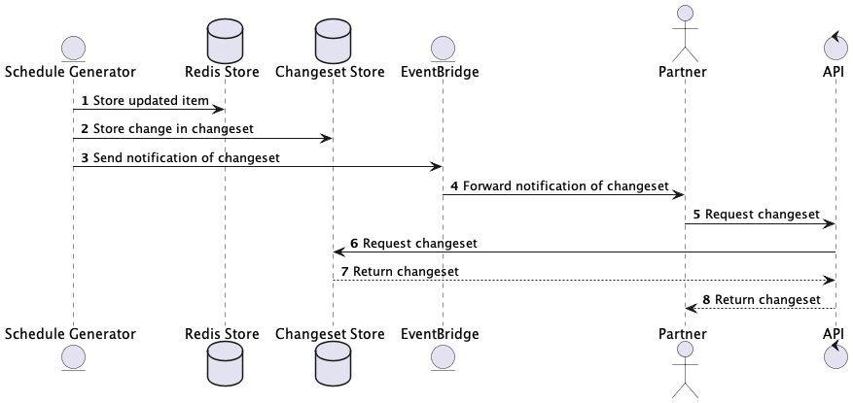
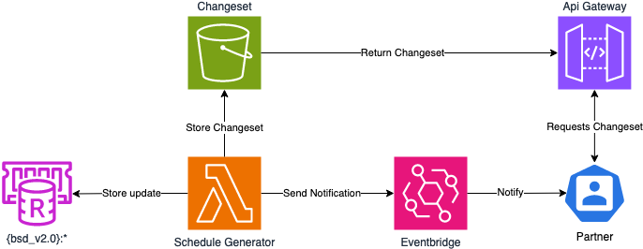
Future Work (Changesets/Notifications to Partners)
A system could be designed where partners are alerted to changes in the data.
This would mean they only need to update data which has changed, instead of re-requesting every schedule they are interested in on an interval.

Slide 50

Questions

